Slide 2
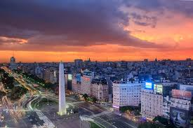
DOING BUSINESS IN ARGENTINA

Slide 3
TOPICS OF THE PRESENTATION:
Overview of Argentina
Protection for Foreign Investors – Legal Framework
Structuring the deal – Legal Updates

Slide 4
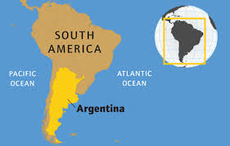
1) OVERVIEW
Territorial size: 2nd Latin America
8th world
Area: 2.78 million Km2
Population: 44.04 million

Slide 5
POLITICS:
Representative, Republic and Federal government.
Branches:
Executive, headed by the President;
Legislative, “Congress” Senate & Deputies; and
Judicial

Slide 6
Capital City: Autonomous City of Buenos Aires (ACBA)
Argentina:
23 provinces and ACBA
Each province:
autonomous
3 branches, own constitutions
further divided into municipalities

Slide 7
ARGENTINA BACKGROUND:
For 12 years Argentina was largely disconnected from the world
Government embraced a market friendly approach with the business community and investors

Slide 8
New government since December 2015 initiated a series of reforms that were aimed at:
1) reintegrating Argentina into the world and
2) producing economic growth,
3) stability and
4) predictability.

Slide 9
ARGENTINA’S ECONOMY
Argentina is the 2nd largest economy in Latin America
Highly diversified economy:
Agribusiness – 3rd world largest producer of Genetically Modified crops
Automotive
Pharmaceuticals
Chemicals & Petrochemicals
Biotechnology
Textiles
Metalworking
Cement and construction materials

Slide 10
1) World leading food producer:
3rd in the world for soybean,
4th soybean soil, soybean meal and sunflower,
6th producer of corn and
7th of barley
2) 4th largest shale oil and 2nd largest shale gas reserve (Vaca Muerta)
3) Other valuable resources include: gold, copper, lead, zinc, lithium, etc.

Slide 11
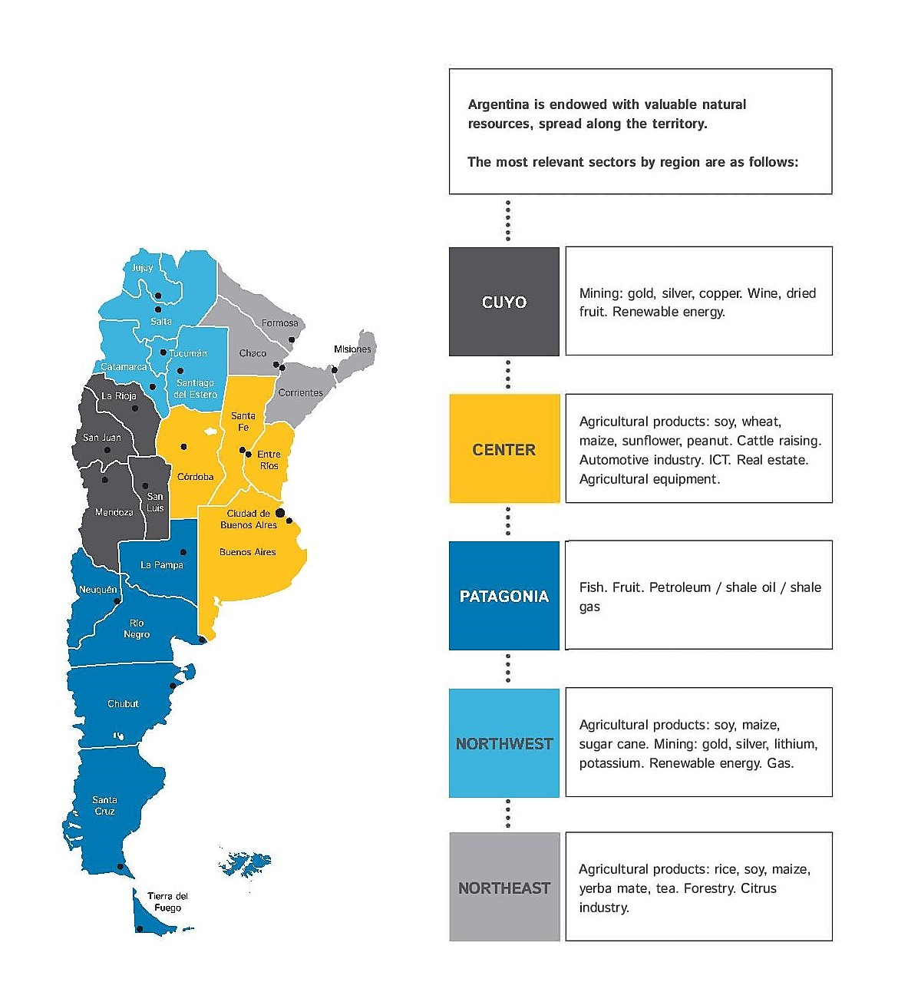

Slide 12
2) FOREIGN INVESTMENT PROTECTION – LEGAL FRAMEWORK
Foreign investors are protected by international and domestic legislation
Argentina is a SAFE destination for foreign investment

Slide 13
INTERNATIONAL PROTECTION
Argentina:
60 Bilateral Investment Treaties (BIT), which provide broad protection to foreign investors ensuring:
Fair and equitable treatment;
Repatriation of investments and returns;
Protection against expropriation; and
Resort to international arbitration.

Slide 14
member of the International Centre for Settlement of Investment Disputes (ICSID) since 1994,
Observer of the OECD Investment Committee since 1996, and
member of the Multilateral Investment Guarantee Agency (MIGA),
provides insurance coverage for foreign investments against non-commercial risks (i.e. political risk).

Slide 15
DOMESTIC PROTECTION
Argentine Constitution: foreigners have the same rights as natives
Foreign Investment Act:
Same rights and obligations granted to national investors;
Access to all sectors of the economy;
Repatriate the net profits derived from their investments, and
Access to domestic credit on the same terms available to local companies.

Slide 16
RESTRICTIONS:
1) Telecommunications
Foreign individuals may NOT hold telecommunication licenses; and
foreign legal entities may only hold up to 30% of voting shares of licensed telecommunication companies (provided they do not hold control of the company).

Slide 17
2) Land
Foreign individuals and legal entities (and local companies controlled by foreign entities)
may hold up to 15% of the country’s rural lands; (within such percentage, only 30% can be held by same foreign nationality)
may only own up to 1,000 hectares individually in the core area (“humid pampas”);
and may NOT own or possess land containing or bordering permanent water reservoirs; or located in border security areas (unless authorized).

Slide 18
Restrictions do not apply to the foreign individuals who:
Resident in Argentina for 10 years; or
Argentine children + resident 5 years; or
married to Argentine for 5 years and prove residence.

Slide 19
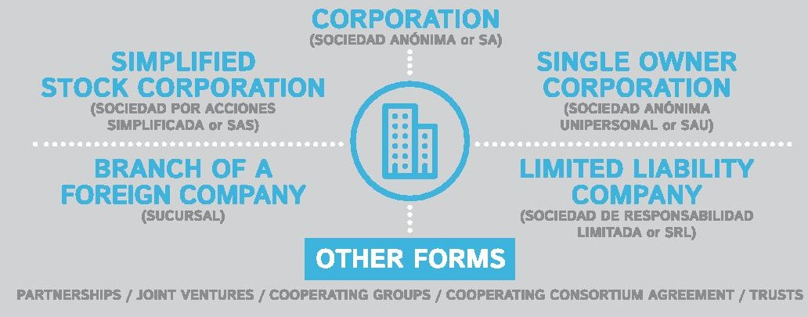
FORM OF FOREIGN INVESTMENT – STRUCTURING THE DEAL
FORM OF FOREIGN INVESTMENT – STRUCTURING THE DEAL
A foreigner wanting to do business in Argentina may elect to:
set up a branch,
acquire a participation in a local company, or
incorporate a new subsidiary in the country.
It may also trade its products through an agency or distribution agreements.

Slide 20
The most popular investment vehicles for foreigners are:
To set up a branch,
To acquire a participation in a local company, or
To incorporate a new subsidiary in the country.

Slide 21
1) A BRANCH
NOT a separate legal entity from the Foreign Company (FC)
FC directly responsible for liabilities incurred by the branch
Total value of the capital of the headquarters, - not just capital assigned to branch, subject to the responsibility for all transactions made by the branch.

Slide 22
Existence and validity of branch governed by laws of the country of origin
Branch can undertake all activities to which the company's head office is dedicated to
Required to keep separate accounts from the operations of its head office.

Slide 23
Managed by a resident legal representative -broad administrative and judicial authority to conduct the transactions of the branch-
Foreign investors must register with Registry of Commerce (IGJ).
Subject to the supervision of the Commercial Registry

Slide 24
2 & 3) ACQUIRING A PARTICIPATION OR INCORPORATING A DOMESTIC BUSINESS ENTITY
Foreign investors seeking to:
1) purchase a participation in an existing local company, or
2) planning to incorporate a new domestic business entity,
must register as foreign investors with the Commercial Registry (IGJ).

Slide 25
As a separate entity, the Argentine subsidiary (and not its parent) will be liable to the extent of the capital contribution.
The most popular forms of business entities are:
1) the corporation (Sociedad Anónima -S.A.-), and
2) the limited liability company (Sociedad de Resposabilidad Limitada - S.R.L-).
3) Simplified Corporation (Sociedad Anónima Simplificada –SAS-)

Slide 26
1) Corporation (SA)
Capital is divided into stock of shares (registered and non-endorsable)
Rights: common or preferred shares
Transfer of shares: generally unrestricted but check by-laws
Shareholders limit their liability to their capital contributions (minimum capital ARS 100,000)

Slide 27
Shareholders must hold at least one regular meeting every year (approve financial statements, appoint remove directors, etc)
Shareholders appoint member of the Board of Directors.
1 or more depending on by-laws.
Majority must be Argentine residents
If capital raises to 50 million pesos 3 directors

Slide 28
2) Limited Liability Company (SRL)
Members limit their liability to the par value of the membership interests (“cuotas”) they agree to subscribe.
Transfer of membership interest are registered with IGJ
Minimum number of membership interest 2 and max 50
No minimum capital required but IGJ requires that capital is adequate to the company’s corporate purpose

Slide 29
SINGLE SHAREHOLDER CORPORATION (SSC)
Recently, SSC have been allowed
Shareholder cannot be another shareholder corporation
100% of capital stock must be paid up upon incorporation
Subject to permanent government supervision and must appoint auditor

Slide 30
THE SIMPLIFIED CORPORATION – LEGAL UPDATE
“Entrepreneurs Act”, new company type - SAS-
SAS principle “freedom of contract” – unlike SA or SRL-, with very few mandatory provisions, making it a:
very flexible,
fast to incorporate,
highly customizable, and
cost-effective legal vehicle.

Slide 31
MAIN FEATURES
1) Incorporation by one or more individuals or legal entities
No nationality, nor residence requirement to be a shareholder of a SAS
2) Created electronically
Registered and Tax ID within 24 hours, provided shareholders choose model articles of association

Slide 32
3) Plural corporate purposes allowed (activities of said plural corporate purpose do not need to be related)
very few restrictions -most significant one: SAS not allowed to offer their equity or debt securities to the general public-
4) Minimum stock capital: two monthly minimum salaries
5) Shareholders limit their liability to their contribution

Slide 33
6) Managers have to be individuals
Argentine citizens or foreign individuals
only one of them must reside in Argentina
Foreign managers must:
get a tax ID
appoint a legal representative in Argentina
set a legal address in Argentina

Slide 34
7) Can keep their corporate and accounting books by electronic means.
Not required to submit financial statements to the Public Registry;
Most of the above-listed features are NOT allowed for corporations nor for limited liability companies.
Conclusion: except for those companies wishing to go public, the SAS offers advantages unmatched by the other company types in Argentina, whether for Argentine or international clients

Slide 35
REQUIREMENTS AND TIMING – LEGAL UPDATE
New government simplified the registration process of foreign companies wanting to do business in Argentina.
Change effective since 30 August 2018.
See General Resolution of Public Registry (Inspeccion General de Justicia) No 6 / 2018.

Slide 36
MOST SIGNIFICANT CHANGES
Foreign companies no longer have to
1) name ultimate beneficial ownership
2) show evidence of the existence of assets or significant economic activities abroad
Before FC show evidence of overseas substance
substantial part of the entity’s activities and assets are located outside Argentina and
central management is conducted abroad.
This requirement was aimed at confirming that the entity is a “true” foreign company, and not just a shell or paper company

Slide 37
3) The Annual Reporting Regime has been abolished.
Once registered with the Public Registry, foreign companies will not need to submit yearly documents and information on their assets, business activities and shareholders;
If FC are incorporated in non-cooperative jurisdictions for
fiscal transparency,
Money Laundering, and / or
Financing of Terrorism,
the IGJ will require proof on the existence of significant economic activities abroad, and will strictly evaluate the evidence submitted

Slide 38
REQUIREMENTS AND TIMING
Incorporation of domestic company is a straightforward process
Timing: 2 to 3 weeks
The registrant must:
1) execute a public deed or private instrument,
2) establish a domicile in the applicable jurisdiction and
3) register with the local Public Registry of Commerce, AFIP and local tax authorities.

Slide 39
Presentation by
FEDERICO MIGUEL AMADEO CINCOTTA
Solicitor of England & Wales
And
Argentine Lawyer
Queries: federico.cincotta@cincottaadvisory.com

Slide 40
THANK YOU!

