Slide 1


Slide 2

FAMILY BUSINESS ARGENTINA

Slide 3

PART ONE
REGION’S OUTLOOK
&
INTRODUCTION

Slide 4
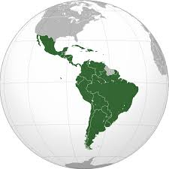
REGION’S OUTLOOK
Family-controlled conglomerates continue to dominate Latin America's private sector

Slide 5
INTRODUCTION
Argentina – third largest economy in Latin America
Family businesses play an important role
  at least 80% of the country’s 1.2 million businesses are privately owned

Slide 6
INTRODUCTION
Generate 80% of work in the private sector
Contributes to more than 50% of Argentina’s GDP
13 - out of the 17 Argentine multinational companies - are or have been until recently Family Business

Slide 7
PART TWO
WHO ARE THEY?
&
CASE STUDIES

Slide 8
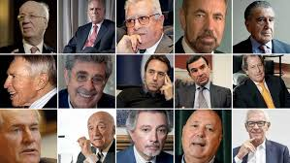
TOP 50 RICH ARGENTINE FAMILIES http://www.forbesargentina.com/50-argentinos-mas-ricos/
70 billion USS altogether
Only 22 made their fortune from 0
Only 7 women in the ranking, and 3 of them share their position with husband or brother

Slide 9
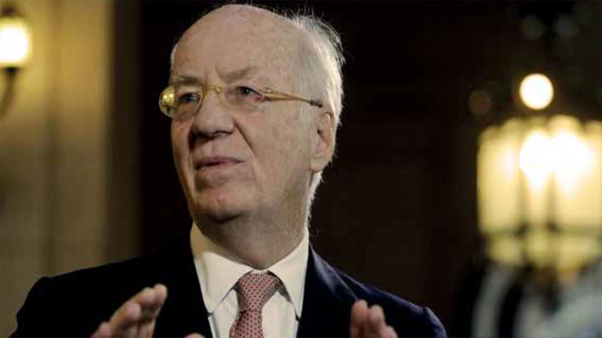
Paolo Rocca and family
US$ 9.7 Billion
ROCCA Family - founder of
TECHINT GROUP

Slide 10

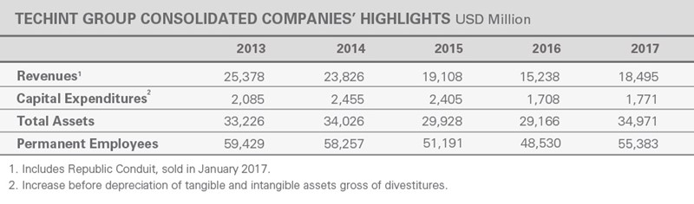
Founded: 1945
Headquarters: Milan & Argentina

Slide 11



TECHINT GROUP
applications
Leading global supplier of steel tubes for the energy sector
Largest steel company in Latin America
Worldwide engineering, procurement, construction, operation and management for high complexity, large-scale projects

Slide 12



TECHINT GROUP
applications
Worldwide partner for innovative, reliable and sustainable solutions in metals and mining
Oil and gas exploration and production company
A network of hospitals in Italy, focused on
Research
Promoting patient-oriented management
use state-of-the-art technology systems

Slide 13

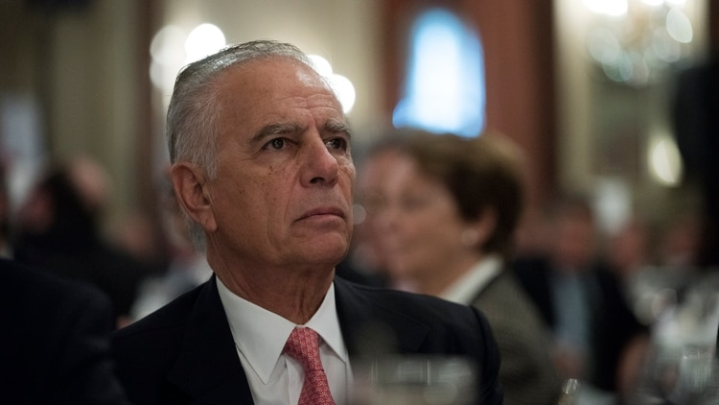
Alejandro Bulgheroni and family
USS 7.3 BILLION
Master and Lord of the hydrocarbons in Argentina

Slide 14

Alejandro Bulgheroni and family
Created in 1948 to provide parts for the national oil company's pipeline network
Alejandro and brother took over from their father in 1985

Slide 15


Alejandro Bulgheroni and family
2011: 50% stake sold to China's state oil company for $3.1 billion
2017: cash-free agreement with BP to form the largest privately-owned integrated energy company, Pan American Energy

Slide 16
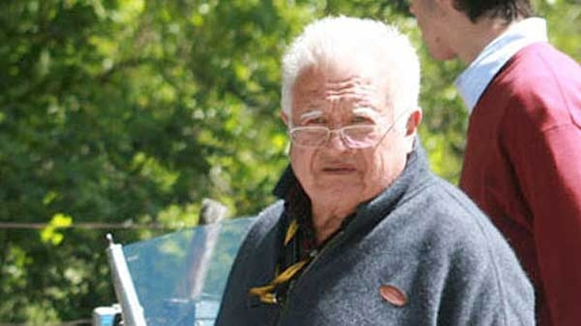
Gregorio Pérez Companc and family
USS 3.9 Billion

Slide 17

Gregorio Pérez Companc
Now retired
Was at the helm of Molinos Rios de la Plata, Argentina’s largest food producer
2009: stepped down and gave his 75% to his children

Slide 18

Gregorio Pérez Companc
Built second largest oil company Perez Companc SA
Sold Petrobas for $1 billion

Slide 19
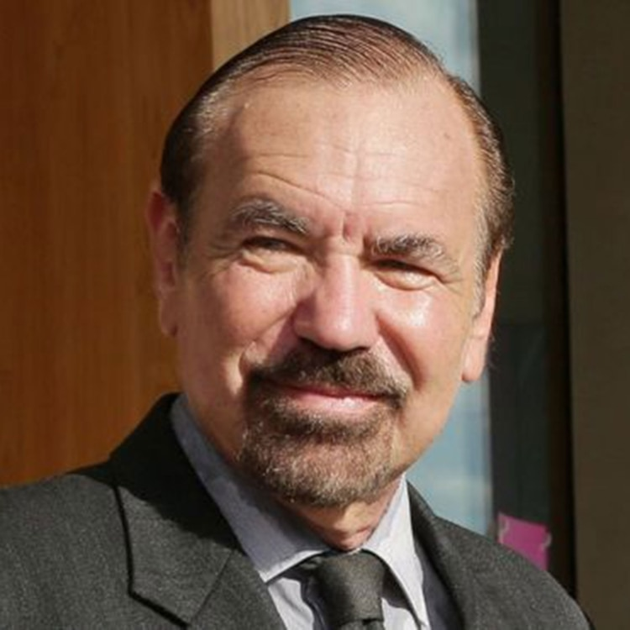
Jorge Pérez
USS 3 BILLION

Slide 20
Jorge Pérez
Known as "the king of condominiums in Miami"
friend of Donald Trump
Jorge Pérez manages Related Group since 1979
Icon Brickell, St. Regis Resort and Residences, Hallandale Beach Club and Trump Hollywood are emblems of its developments

Slide 21
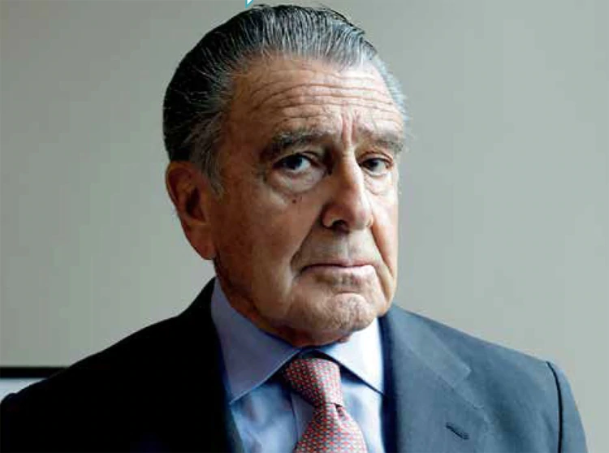
Eduardo Eurnekian
USS 2.7 BILLION

Slide 22

Eduardo Eurnekian
Holds a conglomerate of companies under Corporación América
Corporación América Airports (52 terminals around the world)
Debuted on Wall Street in 2018 and reached US$ 2,8 billion valuation on its first day

Slide 23
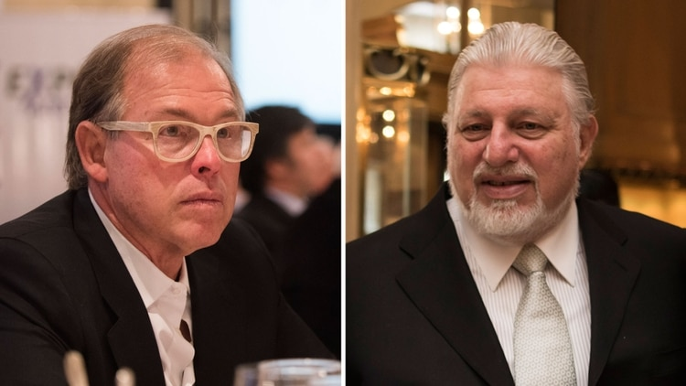
Werthein family
USS 2.3 BILLION
Avid investors, they know when to enter and when to leave, increasing their assets in each movement
They did it with CEI Citicorp Holdings, La Caja de Ahorro y Seguro y Telecom

Slide 24

Edith Rodríguez
USS 2 BILLION
Low profile (nobody knows her face)

Slide 25
Edith Rodríguez
  Richest woman in Argentina
  Owner – with her 3 children - of 70% of shares of PLUSPETROL
  Pluspetrol:
    fourth largest producer of crude in Argentina
    manages the largest gas field in Peru
    assets in other countries in South America and Africa

Slide 26
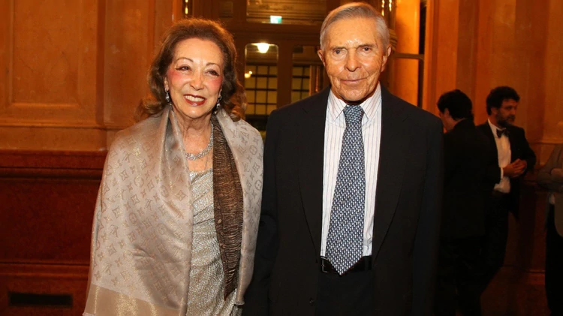
Alberto Roemmers
USS 1.8 BILLION

Slide 27


Alberto Roemmers
Owner of:
1) Roemmers laboratory
  produces 5 of the 10 most sold drugs in Argentina
  presence in 17 markets
  plant production in Ecuador and Uruguay

Slide 28


Alberto Roemmers
2) 44% of shares of Gador laboratory (1 of the top 5 in billing)
3) Investi Farma, pharmaceutical company with revenues of $ 1,5 billion

Slide 29
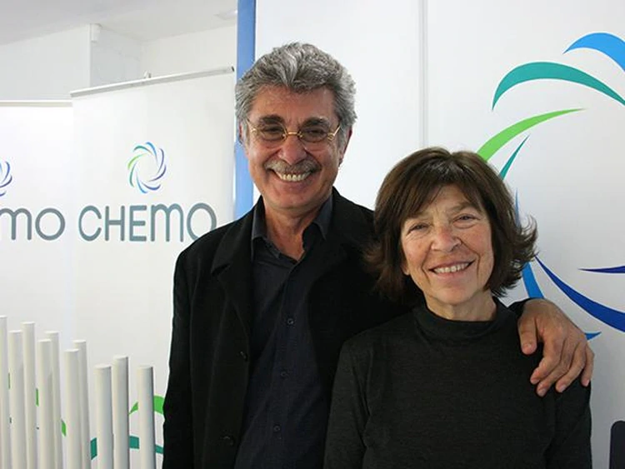
Hugo Sigman y Silvia Gold
USS 1.6 BILLION

Slide 30

Hugo Sigman y Silvia Gold
Owners of Insud Group
Headquarters in Argentina and Europe
Presence in 40 countries (4,000 employees)

Slide 31
Hugo Sigman y Silvia Gold
Started in the pharmaceutical industry (main activity)
Today strong presence in other areas: Agribusiness, cultural industries and nature and design

Slide 32
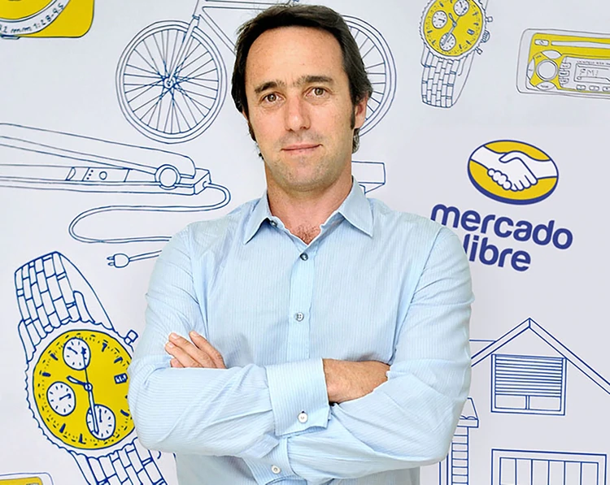
Marcos Galperín
USS 1.6 BILLION

Slide 33

Marcos Galperín
MercadoLibre, e-commerce platform
  operates in 18 countries
Since its public offering in 2007 on NASDAQ, its valuation ascended uninterruptedly
MARKET VALUE of USS 17.13 billion

Slide 34
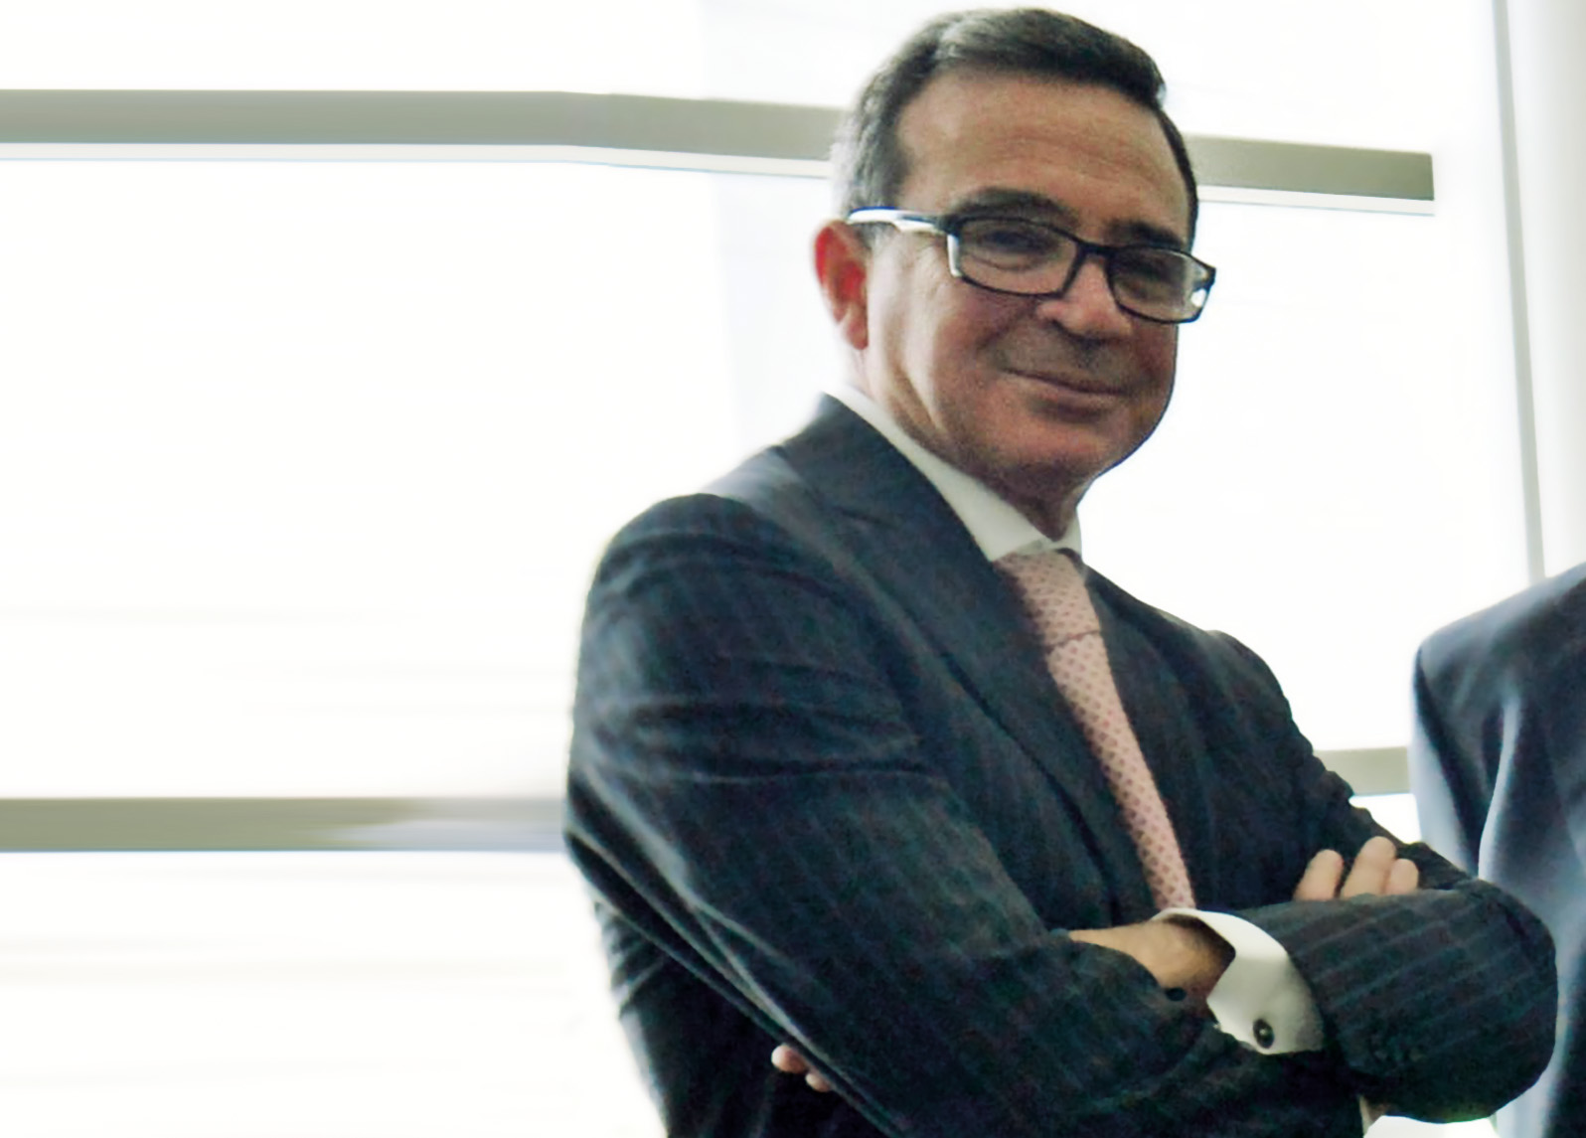
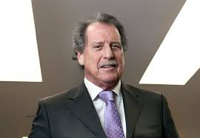
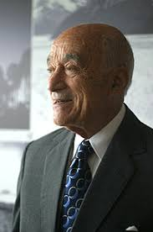
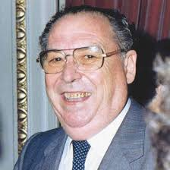
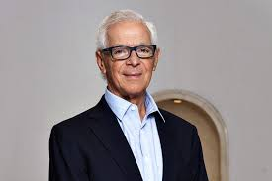
Quintanilla
Brito
Eskenazi
Urquia
Constantini
1.6 Billion
Aluar
1.5 Billion
Banco Macro
1.3 Billion
YPF and banks
1.2 Billion
Biggest trader of grains
1.2 Billion
Real estate

Slide 35
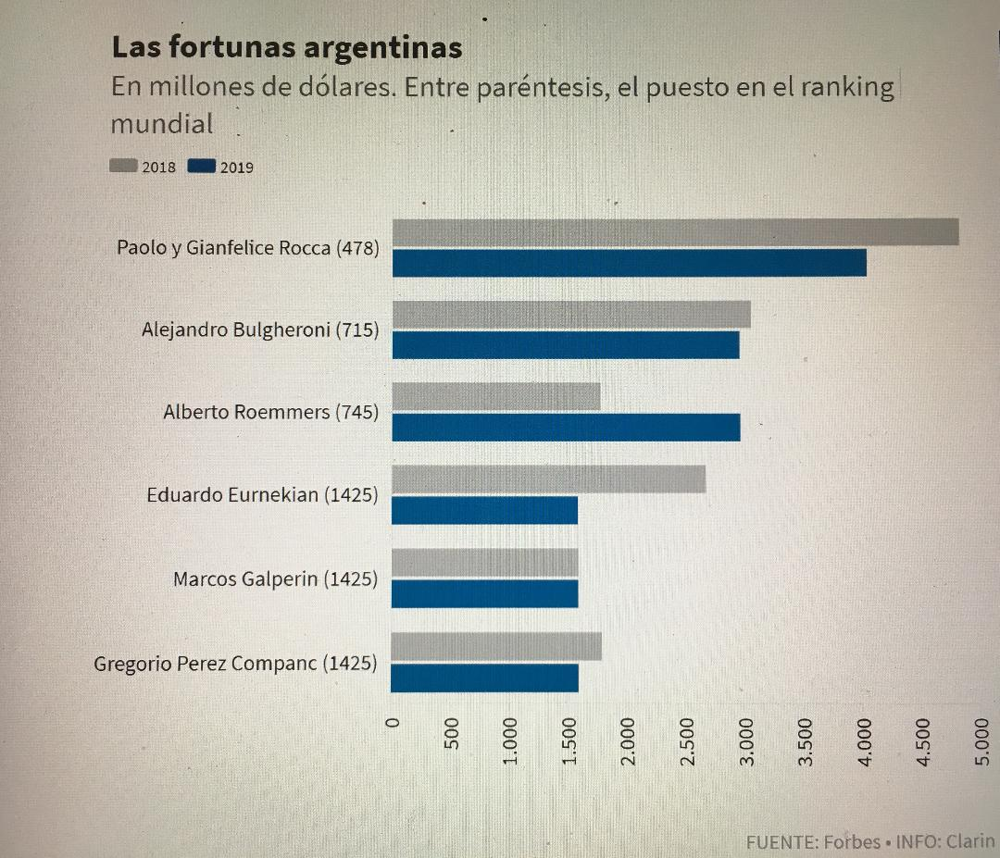
WORLD WIDE RANKING

Slide 36

CASE STUDY - ARCOR
Argentina's Biggest Food Company is looking to go global
Arcor will eventually hold share offering
Before listing will target acquisitions in Mexico and Brazil

Slide 37
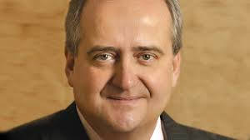
CASE STUDY - ARCOR
World’s biggest maker of hard candies
Seeking a strategic partner to expand outside Latin America
Willing to do a stock swap with a partner to get access to more overseas markets, especially in Asia
Luis Pagani “Arcor’s family ownership might appeal to other global candy makers that value similar structures, such as Ferrero International SA and Mars Inc”

Slide 38
CASE STUDY - ARCOR
Pagani:
“Arcor will likely seek to sell shares at some point, and Argentina has become a favourite of emerging-market investors looking to profit from President Mauricio Macri’s pro-business policies, but Pagani says he feels no pressure to rush an offering right now”

Slide 39
CASE STUDY - ARCOR
Lowest borrowing cost among Argentine peers
Moody’s Investors service rates Arcor’s $500 million bonds
Since notes were sold -June 2016-, returned 15%, beating the emerging-market corporate average of 9.8%

Slide 40



CASE STUDY - ARCOR
Revenue $3.1 billion –Argentina’s biggest food producer
Owns 51 percent of Bagley Latinoamerica SA (remaining stake held by Danone)
Strategic alliance with Bimbo SA in Mexico
Branding alliance with Coca-Cola to sell products in Peru

Slide 41
CASE STUDY - ARCOR
Arcor will seek to make acquisitions in Latin America:
  particularly consumer, agribusiness and packaging businesses in Mexico and Brazil,
Pagani said it could pay for by using its cash flow taking on new debt

Slide 42


CASE STUDY - ARCOR
Brazil: antitrust regulator may force Nestle SA to divest from some of its businesses
Mexico: appealing consumer sector as the market is heavily segmented and Mexicans are high sugar consumers

Slide 43

CASE STUDY - ARCOR
Arcor is testing other agribusiness ventures (apart from sugar cane)
2015 Mastellone Partnership -largest dairy producer –
Option to become controlling shareholder by 2021, or earlier paying premium to Mastellone bondholders
Association: opened the door to exporting milk-based products to Africa, the Middle East and Asia

Slide 44

CASE STUDY

Slide 45
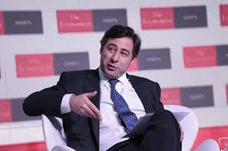
CASE STUDY –
Martin Eurnekian CEO
39 years old – nephew of Eduardo Eurnekian
Family’s also owns energy assets, a semiconductor maker and real estate

Slide 46

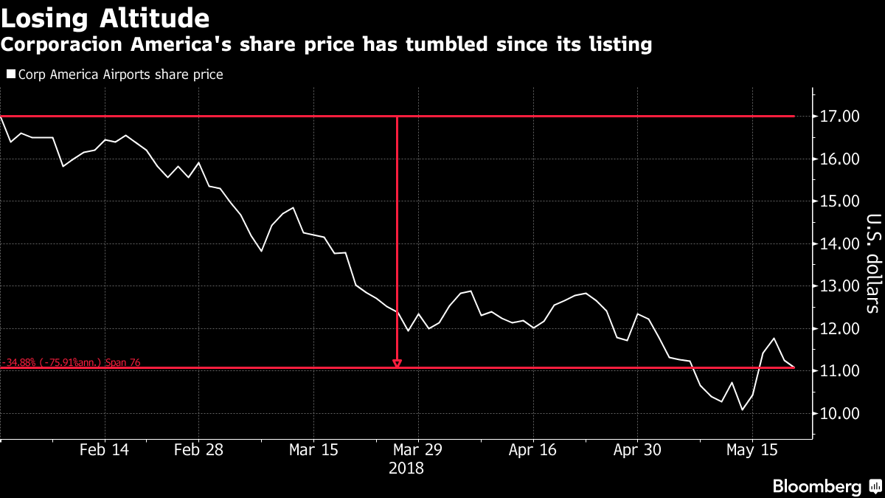
CASE STUDY –
Largest private airport operator in the world by number of airports
Operates 52 airports in 7 countries in 2 continents (eyeing India and Africa)
Difficult introduction to the markets - shares tumbled 50 percent since IPO in 2018

Slide 47
CASE STUDY –
Why go public?
IPO was not motivated by succession. However it will play a big part in it because it forces us to stop being a private family-owned company that basically runs by our own rules
Now we have governance policies, investors and compliance
“Sometimes in family-owned companies that might not be the case”

Slide 48
CASE STUDY –
How does the family manage its varied interests?
The founder -Eduardo- leads:
1) strategy &
2) big decisions
“We are fairly diversified… Therefore family members can run different businesses so we are not bumping into each other every day, which sometimes creates tension in family-owned businesses”

Slide 49
PART THREE
ANALYSIS

Slide 50
WHAT DO THESE FAMILIES EXPECT?
PUBLIC RECOGNITION for role they play in the economy
CHANGES around TAXATION
Easier ACCESS to LOANS

Slide 51

LATIN AMERICA - STRONG FAMILY LINKS
Family businesses in Latin America are strong partly because the extended family itself is strong
“no clear-cut separation between family interest and business interest, or between the person of the owner and the legal personality of the firm”
average number of family members on the board

Slide 52
CHALLENGES FOR FAMILY BUSINESS
Strong family links clash with maximising profits
Many family businesses lost rankings positions
  refused to consolidate business in a professionally managed holding company, and failed to seek foreign allies
“Foreign businessmen are rarely flexible on matters such as providing jobs for relatives, handling expense accounts, arranging for convenient work schedules, allowing for cash withdrawals and safeguarding personal prestige”

Slide 53
LEGAL REGULATION
No specific legal regulation for family business
Nor for companies - when the family business is legally structured through a corporate type
Covered by a series of dispersed norms: Civil and Commercial Code, labour legislation, etc

Slide 54
TOP CONCERNS FOR FAMILY BUSINESS

Slide 55
HOW CAN WE HELP THEM?
Family Business need to consolidate their business a professionally managed holding company and will seek foreign allies
Different legal instruments can help towards the organization, preservation and succession of the family business

Slide 56
Family protocols and partner agreements
Best company type
Restrictions on transfer of shares or other equities interests to third parties, including by death
Inheritance Pack
Donations
Resolving Disputes
(Mediation – Arbitration)

Slide 57

20% family business have a formal succession plan
8% have a working protocol

Slide 58
Building Family Governance
Managing Differences
Fostering Responsible Ownership
Managing Communication – Owner and the Board -
Professionalising the Board
Employing Advisers
Planning Succession

Slide 59
THANK YOU!

Slide 60
PLEASE CONTACT
FEDERICO CINCOTTA
- Solicitor of England & Wales
And
Argentine Lawyer-
FOR MORE INFORMATION
Queries: federico.cincotta@cincottaadvisory.com

