Slide 1


Slide 2
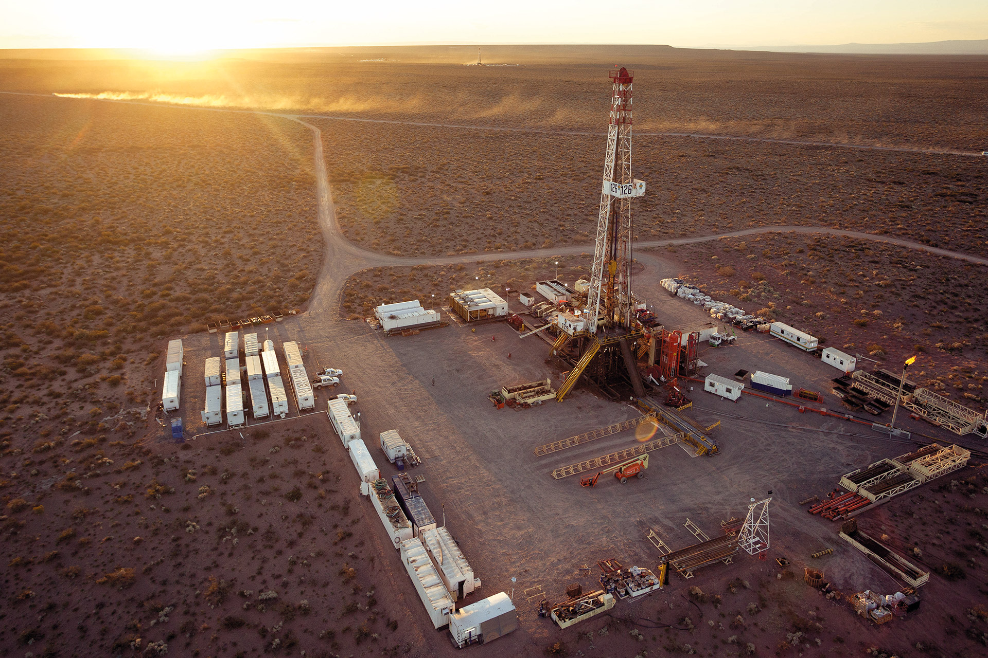

OIL & GAS
ARGENTINA
OIL & GAS ARGENTINA

Slide 3
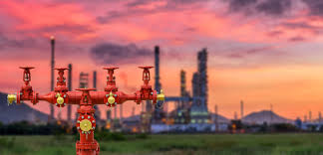
FIRST PART
INTRODUCTION
WHY ARGENTINA?
WHY INVEST IN VACA MUERTA?
INTRODUCTION

Slide 4

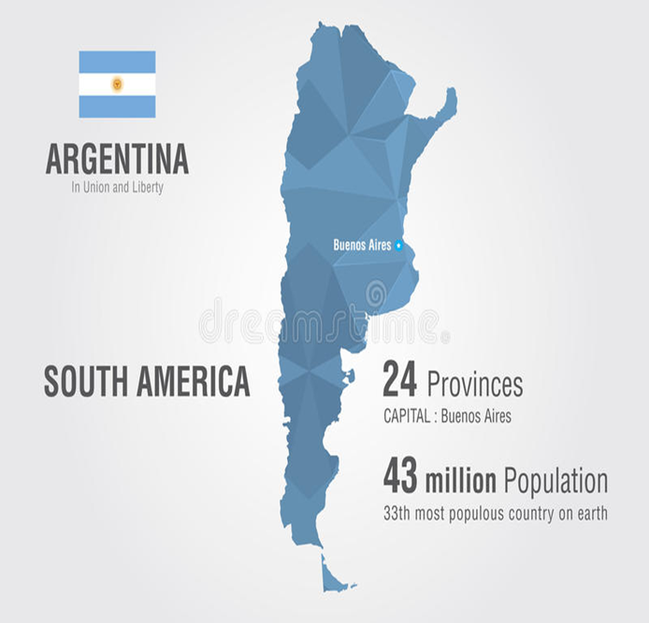

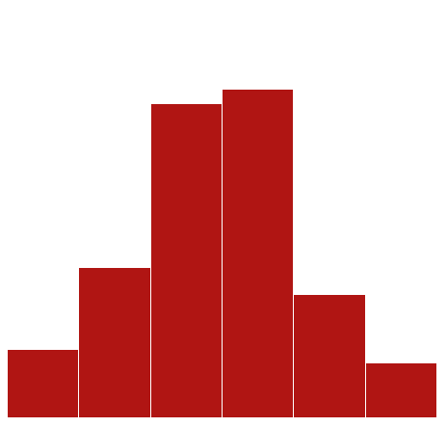
WHY ARGENTINA?
WHY ARGENTINA?
3rd largest Latin American economy
Government embraced a market friendly approach with the business community and investors
3RD largest Latin America economy
Argentina has been re-inserted to the world

Slide 5
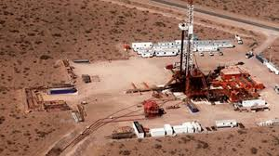
SECOND PART
WHY INVEST IN VACA MUERTA?
Area of ​​36,000 km2, (dimension of Switzerland or the Netherlands)
4 geological properties that distinguish Vaca Muerta as a unique shale formation in the world:
Important amount of Total Organic Carbon (TOC),
high pressure,
good permeability and
great thickness
Vaca Muerta

Slide 6
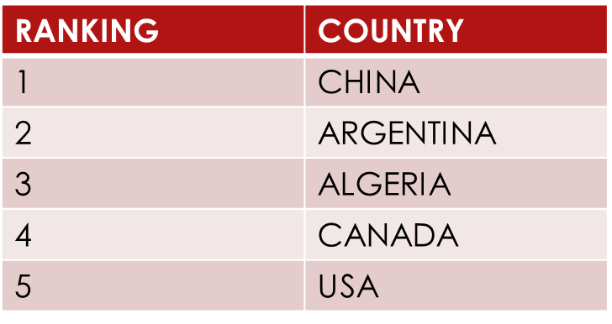
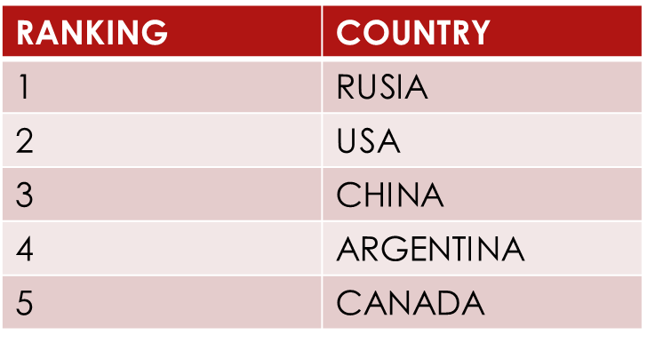
HUGE POTENTIAL – DEVELOPMENT UNCOVENTIONAL HYDROCARBONS
2nd IN THE WORLD
UNCOVENTIONAL GAS RESOURCES
4th IN THE WORLD
UNCOVENTIONAL OIL RESOURCES
ARGENTINA: 802 TRR
TRR: Technical Recoverable Resource
ARGENTINA: 27 BILLION BARRELS
More than 40% of these resources are in the Neuquina basin
https://www.wri.org/sites/default/files/wri14_report_shalegas_execsummary.pdf

Slide 7
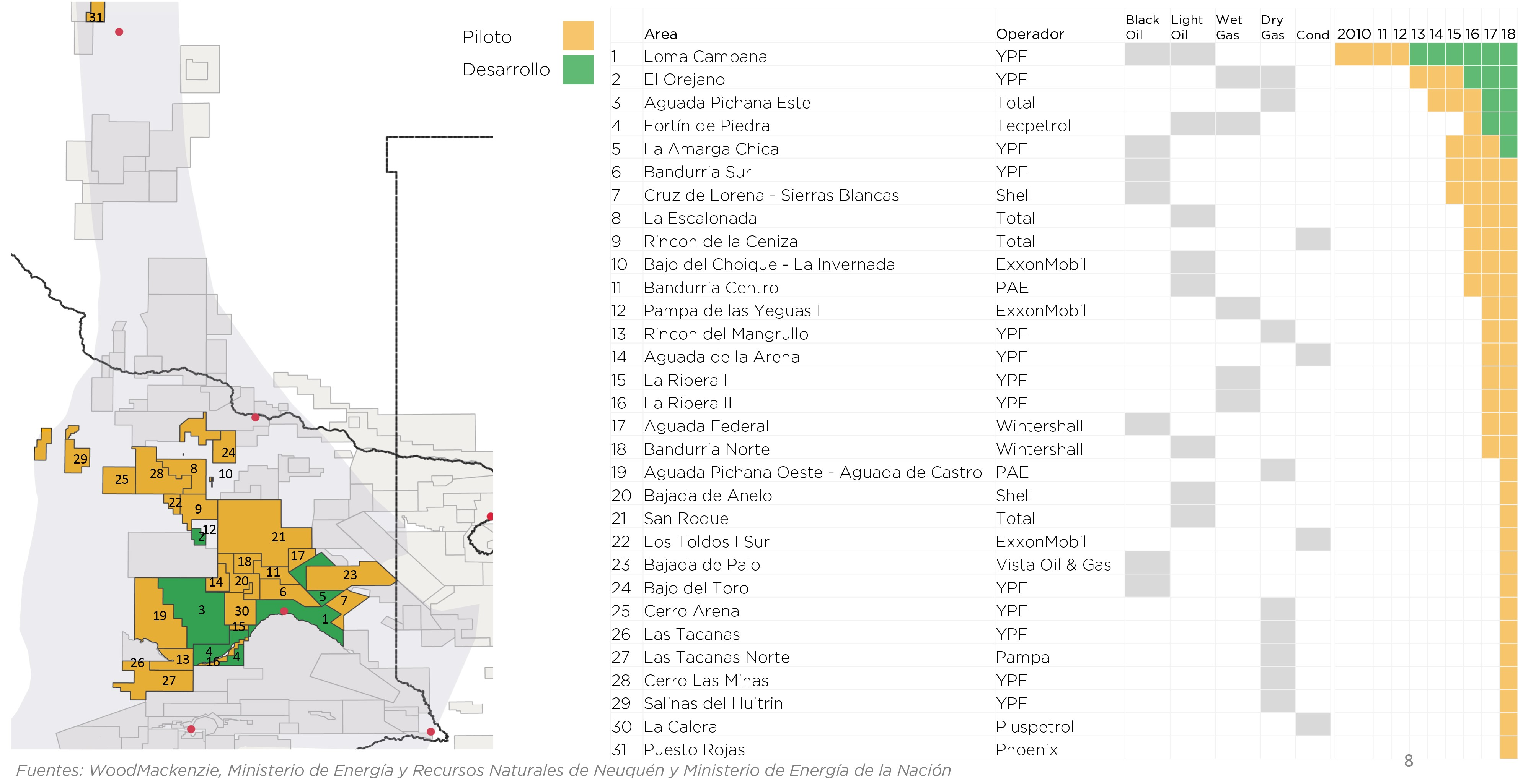
31 KEY PROJECTS
Porque hay oportunidades:
áreas que no fueron adjudicadas
posibilidades de asociación con otras compañías.
Se pasó de la etapa de exploración a la de desarrollo
Más tarde se podrá entrar, por supuesto, pero a un costo mayor.
https://www.argentina.gob.ar/vaca-muerta/mas-indicadores-del-proyecto

Slide 8
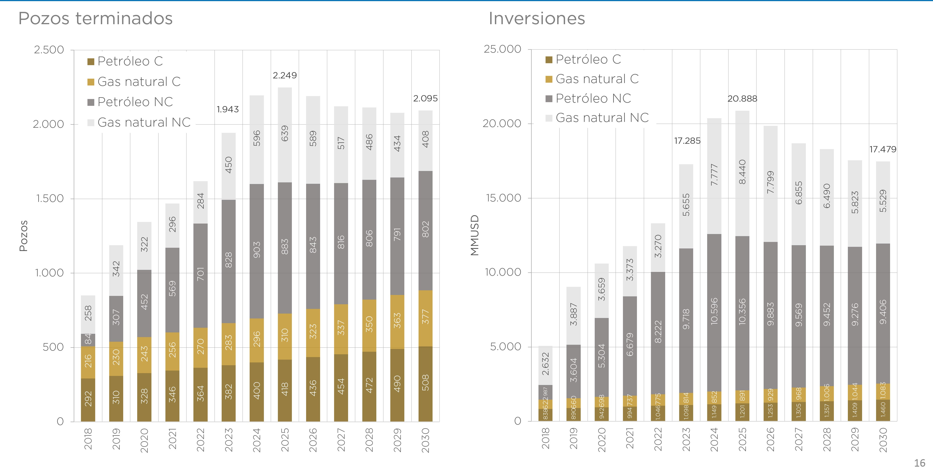
WELLS & ASSOCIATED INVESTMENTS
Porque hay oportunidades:
áreas que no fueron adjudicadas
posibilidades de asociación con otras compañías.
Se pasó de la etapa de exploración a la de desarrollo
Más tarde se podrá entrar, por supuesto, pero a un costo mayor.
https://www.argentina.gob.ar/vaca-muerta/mas-indicadores-del-proyecto

Slide 9
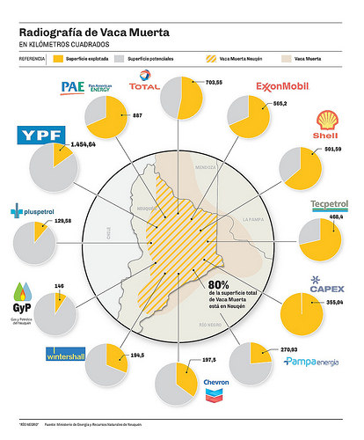
MAIN COMPANIES THAT INVEST IN VACA MUERTA

Slide 10
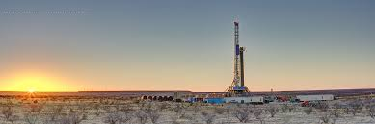
CURRENT LEGAL FRAMEWORK FOR OIL & GAS INDUSTRY

Slide 11
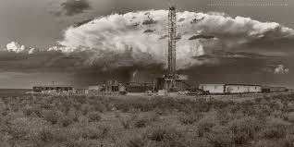
FEDERAL HYDROCARBONS LAW provides for a concession system regime
ARGENTINE CONSTITUTION: natural resources belong to the provinces
Oil provinces as owners of the hydrocarbons grant the concession but subject to the Federal Hydrocarbons Law
Producers are entitled to exploit and commercialize the hydrocarbons obtained

Slide 12
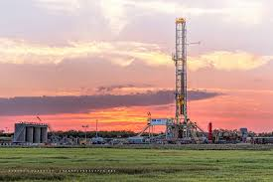
2014: REFORM TO THE FEDERAL HYDROCARBONS LAW TO MEET THE NEEDS OF VACA MUERTA
UNCONVENTIONAL CONCESSIONS: Defined based on target formation and the techniques employed for drilling
Conventional title holders are entitled to request unconventional concessions
PILOTS UP TO 5 YEARS ALLOWED
TERM: extended from 25 to 35 years with successive and unlimited renewals based on extended investment
ESTABLISHES A 12% ROYALTY, PLUS 3% FOR EACH EXTENSION OF A CONCESSION, LIMITED TO 18% MAXIMUM

Slide 13
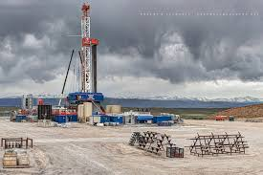
UNCOVENTIONAL PROJECTS BECOME ELEGIBLE FOR EXPORT BENEFITS FOR UP TO 20% OF OVERALL PRODUCTION (NO RESTRICTIONS TO EXPORT, NO EXPORT DUTIES)
NO RESERVES AREAS FOR STATE OWNED COMPANIES. YPF IS SUBJECT TO GENERAL RULES

Slide 14
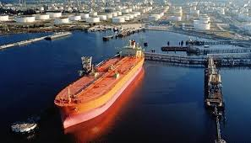
REGULATORY CHALLENGES FOR
CRUDE OIL EXPORTS
Argentine Government should liberalize crude oil exports only retaining the right to oversee adequate supply of the domestic market
Current system of offers to local market prior to export should be replaced by a more agile system such as semi-automatic export licence

Slide 15
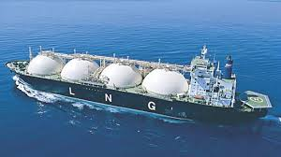
REGULATORY CHALLENGES
LNG EXPORTS
New legislation is needed so that LNG business are independent from the gas regulated market in Argentina (transportation and distribution of domestic supply)
New legislation should be aimed at permitting long term investors
1) secure the supply from dedicated gas fields
2) contract firm transportation capacity with midstreamers
3) obtain long export licences from government

Slide 16
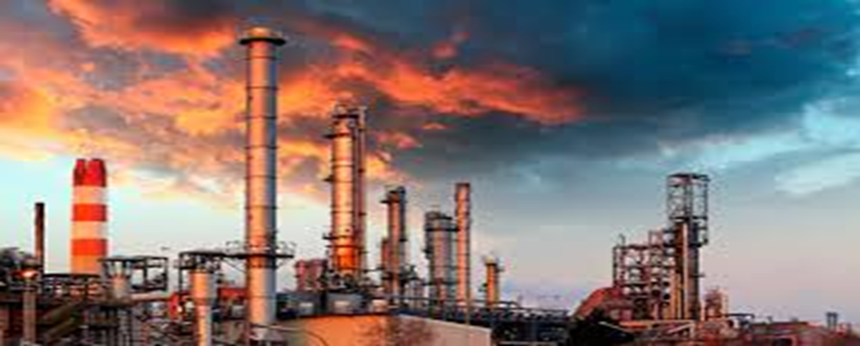
GOVERNMENT MEASURES TO BOOST THE OIL & GAS SECTOR
Government measures to boost the Oil & Gas sector

Slide 17
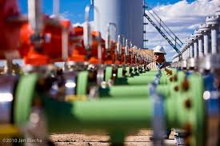
REFORM TO THE CONCESSION REGIME FOR TRANSPORT OF HYDROCARBONS
“necessary to have more infrastructure for evacuation, transportation and storage of hydrocarbons” Decree 115/19
Midstreamers can freely negotiate long term transport and processing capacity with producers
Government to call for tender for main trunk gas pipeline to evacuate Vaca Muerta gas production
http://servicios.infoleg.gob.ar/infolegInternet/anexos/315000-319999/319682/norma.htm

Slide 18
NEW “PLAN GAS” – Res. 46 y 419/17
Encourages unconventional natural gas production investments in the Neuquén basin, guaranteeing a minimum price for consumption in the local market of
“STIMULUS PRICE”
VALUE USD/ MMBTU | YEAR
7.50 | 2017
7.50 | 2018
7.00 | 2019
6.50 | 2020
6.00 | 2021

Slide 19
NEW “PLAN GAS”
Government actually pays via subsidy is the difference between the “Stimulus Price” and the market price
Example: if market price – mix of local production + import – is USS 4 / MMBTU the subsidy would be USS 3 / MMBTU
Government
1) Limited the Plan to the 8 projects that have been incorporated to the Plan
2) Imposed limits to the production volumes originally declared by the companies and not to the total production

Slide 20

NEW “Plan Gas”
Most affected company
Investment in Fortín de Piedra of 2.3 billion (1.8 already implemented)
Produce 17.5 millon of M3 / of gas per day (equivalent to 12% of the total consumption of the country)
Only recibes stimulus for 8.5 millons of M3/ of gas per day, i.e. half of their production

Slide 21

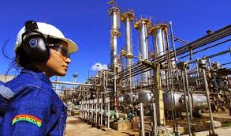

Competitiveness Agreement
Agreement between
Federal Government
Companies
Unions
Objective: Vaca Muerta to become more competitive and reduce labour costs

Slide 22
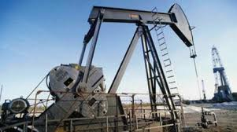
TARIFF REDUCTION/ Decree 629/17
Objective: increase competitiveness in Oil & Gas companies y and speed up investment in Vaca Muerta
Allows the importation of used capital goods (up to 10 years old) for the oil and gas industry with a tariff of:
0% for the most critical equipment and
7% for complementary goods
Objective:
increase competitiveness in Oil & Gas companies
speed up investment in Vaca Muerta
Allows the importation of used capital goods (up to 10 years old) for the oil and gas industry with a tariff of:
0% for the most critical equipment and
7% for complementary goods

Slide 23

Tercera Parte
PROTECTION OF FOREIGN INVESTMENT
Protección de Inversiones extranjeras

Slide 24

Foreign investors are protected by international and domestic legislation
Argentine Constitution: foreigners have the same rights as natives

Slide 25
FOREING INVESTMENT ACT
Access to all sectors of the economy
Same rights and obligations granted to national investors
Repatriate the net profits derived from their investments
Access to domestic credit on the same terms available to local companies

Slide 26












BILATERAL INVESTMENT TREATIES
60 BIT which provide broad protection to foreign investors ensuring:
Fair and equitable treatment;
Repatriation of investments and returns;
Protection against expropriation; and
Resort to international arbitration

Slide 27


Protection for Foreign Investors
Member of the International Centre for Settlement of Investment Disputes (ICSID) since 1994
Member of the Multilateral Investment Guarantee Agency (MIGA),
  provides insurance coverage for foreign investments against non-commercial risks (i.e. political risk).

Slide 28
THANK YOU!

Slide 29
www.cincottaadvisory.com

